Slide 1



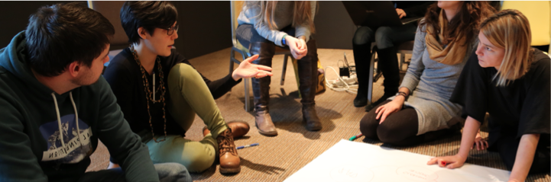

Precarious employment in Croatia
Results ofresearch undertaken for PIE News – Poverty, Income, and Employment News (H2020-ICT.2015).
Maja Pleić, Centar za mirovne studije
Commonfare.net is developed thanks to the project PIE News (www.pieproject.eu) that has received funding from the European Union’s Horizon 2020 research and innovation programme under grant agreement No 687922

Slide 2
Gini coefficient of equivalized disposable income,
Croatia and EU, 1987 – 2017
Source: CMS. Geometar nejednakosti, based on data for Croatia from Eurostat SILC 2017, World Bank Develoment Indicators 2011, UN Rutkowski 1996; dana for EU:Breugel dataset, 2018; Eurostat 2018

Slide 3
At risk of poverty rate in Croatia, by county
Source: DZS, WB, „Hrvatska ocjena siromaštva za mala područja temeljem potrošnje, 2016.

Slide 4
Registered unemployment rate, by county, 2017
Source: Croatian bureau of statistics, „zaposlenost i plaće”, 2018

Slide 5
Precarious employment as % of total employment,
Eurostat old definition, select EU countries, 2002-2015
Source: Eurostat Precarious employment by sex, age and NACE Rev. 2 activity [lfsa_qoe_4ax1r1], 2018

Slide 6
Precarious employment as % of total employment,
Eurostat new definition, select EU countries, 2008-2016
Source: Eurostat Precarious employment by sex, age and NACE Rev. 2 activity [lfsa_qoe_4ax1r2], 2018

Slide 7
Employees with a contract of limited duration, % of total employees, select EU countries, 2006- 2017

Slide 8
Employees aged 15-24 with contracts of limited duration, select EU countries, 2006-2017

Slide 9
Qualitative research with young, precarious workers
N=72, qualitative survey and focus groups
Avg. annual gross income between €5.001,- 10,000.
In the last 12 months, majority was not able to save, majority experienced sometimes or frequently not having enough money to buy needed clothing, to pay for travel costs, to pay for utilities, to pay for a cultural event, to go to a birthday party of a friend, to go to a restaurant with friends
Financial situation of their family: adequate
Individual financial situation: insufficient
77% defined their status as: „niether poor nor rich”, 13% „poor”, 10% „very poor”
„I don’t want to be a complainer” ; „People will think I am lazy”, „Many people have it a lot worse”; „Ok, I may live with my family and cannot afford to do the things I like, but at least I am not hungry and digging through garbage.”

Slide 10
The family as a protective mechanism against the poverty of precarity
Who do you currently live with?
  47/74 (64%) of participants live with their parent(s),
Nationally 73% of young people aged 18-34 live with their parents;
  36% rent with 1+ roommates, 30-50m2, 200€/mj
Do your accomodations meet all your needs?
  85% - somewhat or barely
If you are not satisfied with your living conditions, why do you not move?
  High rental prices
  Insufficient income
When you have financial problems, who do you turn to?
  I turn to my family (92%)

Slide 11
Satisfaction with social relations
From 1-10, how satisfied are you with your relations with the following:
  Friends: 8 (see each other at least 1/week)
  Family: 7.5 (see each other at least 1 / week1)
  Neighbours: 5.2
  Colleagues at work: 6.7
Cultural life
In which cultural activities do you regularly partake?
Going to the cinema (95%), concert (67%), theatre (54%), workshops (33%)
Which cultural activities have you reduced or stopped because of lack of income?
    Buying books (33%), going to concerts (20%), workshops (15%)

Slide 12
At the moment, what are your biggest worries?
64/74 (86%) – employment insecurity
31/74 (42%) – unemployment
25/74 (33%) – insufficient income
What are your biggest worries for the future?
69/74 (93%) – That I will not have sufficient income to live on my own
67/74 (91%) – That I will not be able to take care of myself when I get older
43/74 (58%) – That I will not have my own house/apartment
39/74 (53%) – My pension

Slide 13
Consequences of employment and income insecurity
Inability to plan and develop a career
Inability to buy a home
Inability to start or plan a family responsibly
Discourages investing in further education
Inabilitiy to travel, take vacations, plan trips in advance,
Negative impact on social life, because it costs money to have one
Feelings of self-blame, inadequacy, low self esteem
Depression, anxiety
Pessimism, apathy
Hopelessness for the future

Slide 14
What do you consider the main causes of job insecurity in Croatia?
Corruption
Clientelism and nepotism
The economic situation in the country
Not enough „good” jobs on the market
Inadequate education system that did not prepare us for the labour market of the 21st century
What is most important for getting a job?
„veza”, family, education
„To have a career, not just a temporary job, you need either a connection, a political party, or to be a genius.” M, 35
Commonfare.net is developed thanks to the project PIE News (www.pieproject.eu) that has received funding from the European Union’s Horizon 2020 research and innovation programme under grant agreement No 687922

Slide 15
Corruptive employment practices
Majority of participants had experienced or seen corruptive employment practices at their current or previous job
Not one person reported the corruptive employment practices
General distrust of institutions, disbelief in workers rights
  „ There is no point in reporting anyone. Who will I report him to? The man above him who hired him? Some government office? They are all corrupt. Or our corrupted courts?” M, 28
  „ There is no point reporting these kind of things. That’s just how things function in Croatia. People come to a position of power, they hand jobs out to „their” people, and so on, and so on, all the way to the lady at the chech-out counter. My complaining is not going to change the situation in Croatia.” Ž, 31
  „There is nothing you can do to change this. If you don’t like it, leave.” M,27
Commonfare.net is developed thanks to the project PIE News (www.pieproject.eu) that has received funding from the European Union’s Horizon 2020 research and innovation programme under grant agreement No 687922

Slide 16
What is your ideal job?
„Decent”, „normal”, „stable”
„Where I receive a regular pay, every month”
„Where I am not a slave, or have to endure mobbing just for a little money”
„in my field”, „where I can learn new skills”, „where I can develop my career”
„a pay chech I can live with”, „with a paycheck that covers the basic costs of living in Croatia”, „one that will help me build my future”
„I am not asking for a lot. Just a decent job which will allow me to pay for rent, food, a little bit of leisure, and to help my parents when the time comes. I am not looknig for anything luxurious.” M,30
Commonfare.net is developed thanks to the project PIE News (www.pieproject.eu) that has received funding from the European Union’s Horizon 2020 research and innovation programme under grant agreement No 687922

Slide 17
State institutions and policies
From 1 to 10, how protected do you feel by state policies and programs?
Income support: 2 ; accomodation support: 1 ; healthcare: 6
What kind of services or policies would help improve your situation?
  Services for continued professional development
  Financial support for young or new employees
  Reduced rates for utilities (reduced cost of living)
  Universal basic income for all
  Education grants
  Increases in minimum wage
  Anti-corruption policies
Commonfare.net is developed thanks to the project PIE News (www.pieproject.eu) that has received funding from the European Union’s Horizon 2020 research and innovation programme under grant agreement No 687922

Slide 18
Conclusions
„Flexibilization” = precarization of work
Precarious work has consequences beyond income and emplyoment – impacts feelings of self worth, mental health, living conditions, decisions about starting a family, planning for the future, investing in education, travel and leisure, participating in cultural and social life, and most importantly: hope for the future, and career development.
Young people in Croatia are apathetic, do not believe they can change anything. Believe that the only option for a decent job and decent quality of life is to leave.
Ignoring the needs of young precarious workers already has great consequences for the state of the nation: demography, sustainability of the welfare state, future of the health system, pension system, political scene, cultural scene, brain drain.
Commonfare.net is developed thanks to the project PIE News (www.pieproject.eu) that has received funding from the European Union’s Horizon 2020 research and innovation programme under grant agreement No 687922

Slide 19
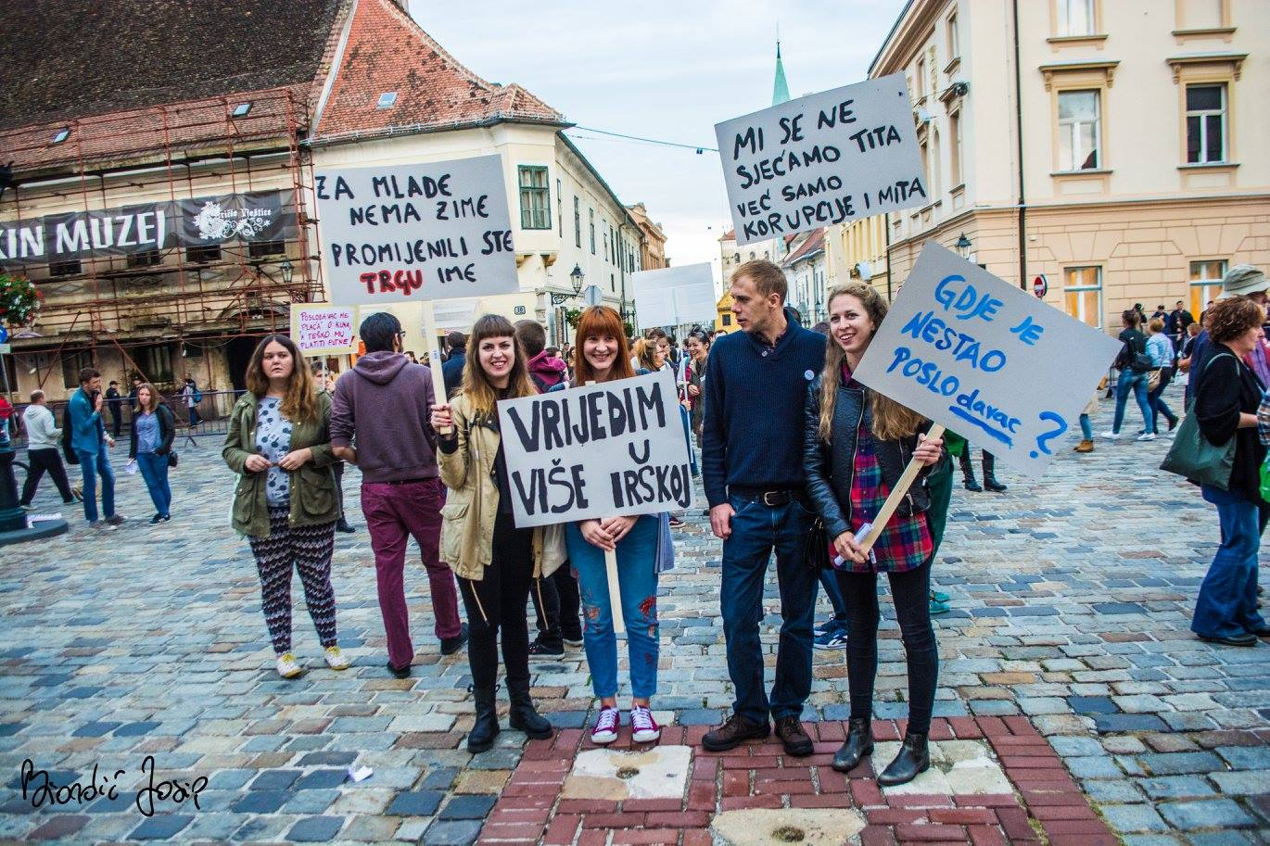

Slide 20
